Slide 1
Chapter 3: Processes

Slide 2
Chapter 3: Processes
Process Concept
Process Scheduling
Operations on Processes
Interprocess Communication
Examples of IPC Systems
Communication in Client-Server Systems

Slide 3
Objectives
To introduce the notion of a process -- a program in execution, which forms the basis of all computation
To describe the various features of processes, including scheduling, creation and termination, and communication
To explore interprocess communication using shared memory and message passing
To describe communication in client-server systems

Slide 4
Process Concept
An operating system executes a variety of programs:
Batch system – jobs
Time-shared systems – user programs or tasks
Textbook uses the terms job and process almost interchangeably
Process – a program in execution; process execution must progress in sequential fashion
Multiple parts
The program code, also called text section
Current activity including program counter, processor registers
Stack containing temporary data
Function parameters, return addresses, local variables
Data section containing global variables
Heap containing memory dynamically allocated during run time

Slide 5
Process Concept (Cont.)
Program is passive entity stored on disk (executable file), process is active
Program becomes process when executable file loaded into memory
Execution of program started via GUI mouse clicks, command line entry of its name, etc
One program can be several processes
Consider multiple users executing the same program

Slide 6
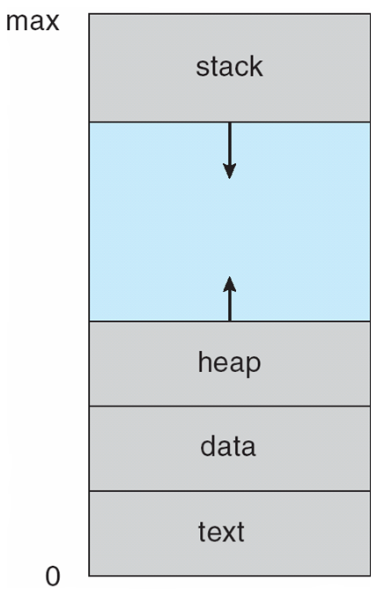
Process in Memory

Slide 7
Process State
As a process executes, it changes state
new: The process is being created
running: Instructions are being executed
waiting: The process is waiting for some event to occur
ready: The process is waiting to be assigned to a processor
terminated: The process has finished execution

Slide 8
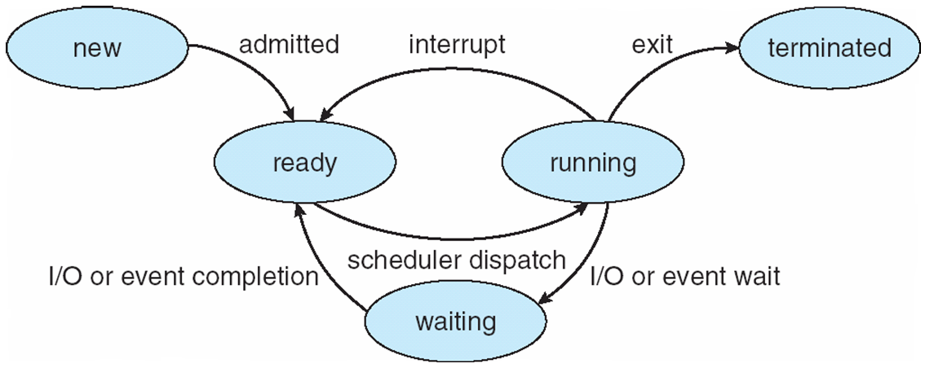
Diagram of Process State

Slide 9
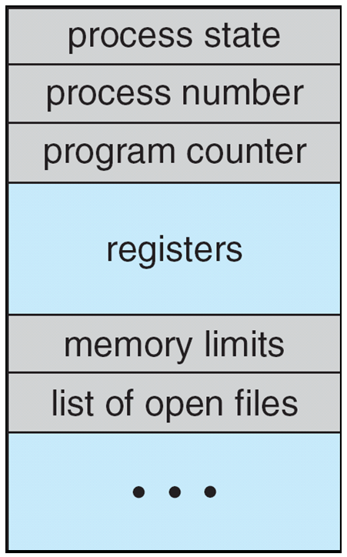
Process Control Block (PCB)
Information associated with each process
(also called task control block)
Process state – running, waiting, etc
Program counter – location of instruction to next execute
CPU registers – contents of all process-centric registers
CPU scheduling information- priorities, scheduling queue pointers
Memory-management information – memory allocated to the process
Accounting information – CPU used, clock time elapsed since start, time limits
I/O status information – I/O devices allocated to process, list of open files

Slide 10
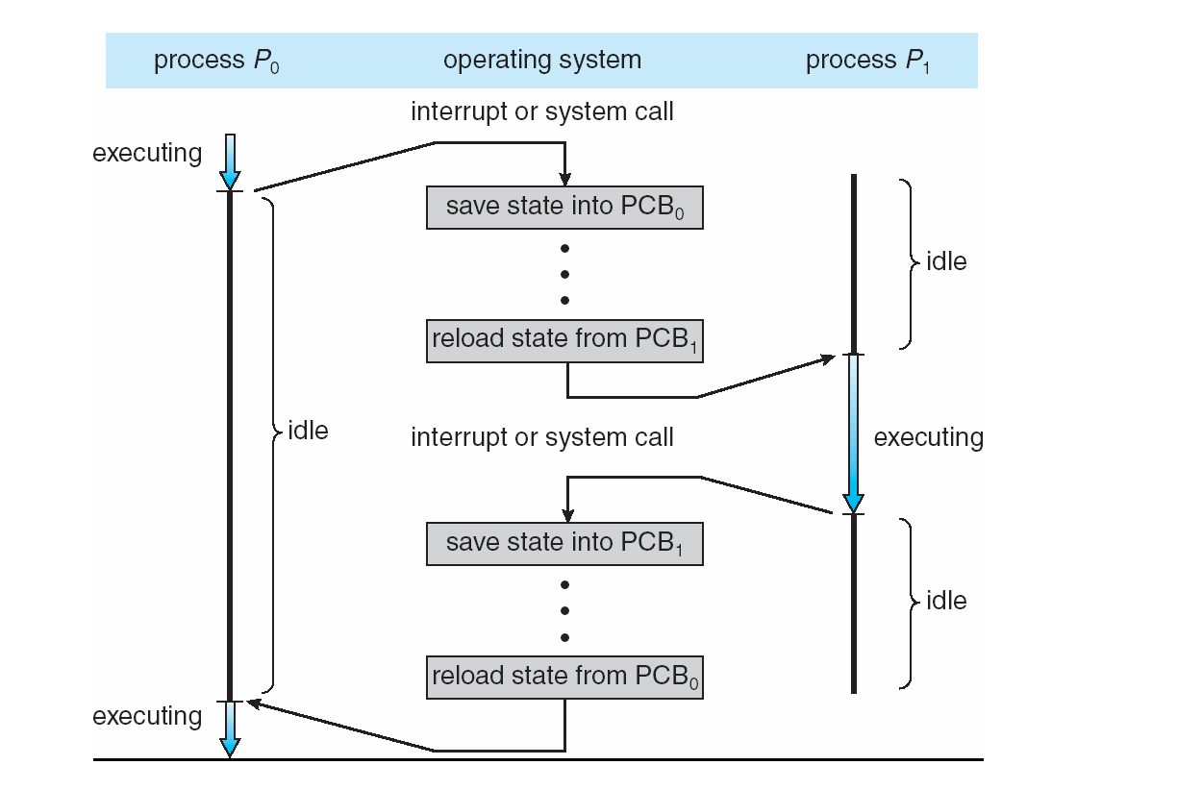
CPU Switch From Process to Process

Slide 11
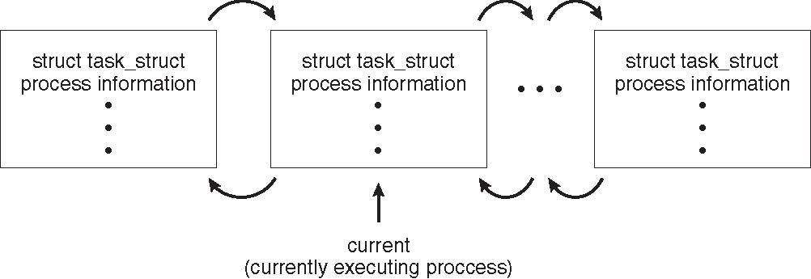
Process Representation in Linux
Represented by the C structure task_struct
pid t_pid; /* process identifier */ long state; /* state of the process */ unsigned int time_slice /* scheduling information */ struct task_struct *parent; /* this process’s parent */ struct list_head children; /* this process’s children */ struct files_struct *files; /* list of open files */ struct mm_struct *mm; /* address space of this process */

Slide 12
Process Scheduling
Maximize CPU use, quickly switch processes onto CPU for time sharing
Process scheduler selects among available processes for next execution on CPU
Maintains scheduling queues of processes
Job queue – set of all processes in the system
Ready queue – set of all processes residing in main memory, ready and waiting to execute
Device queues – set of processes waiting for an I/O device
Processes migrate among the various queues

Slide 13
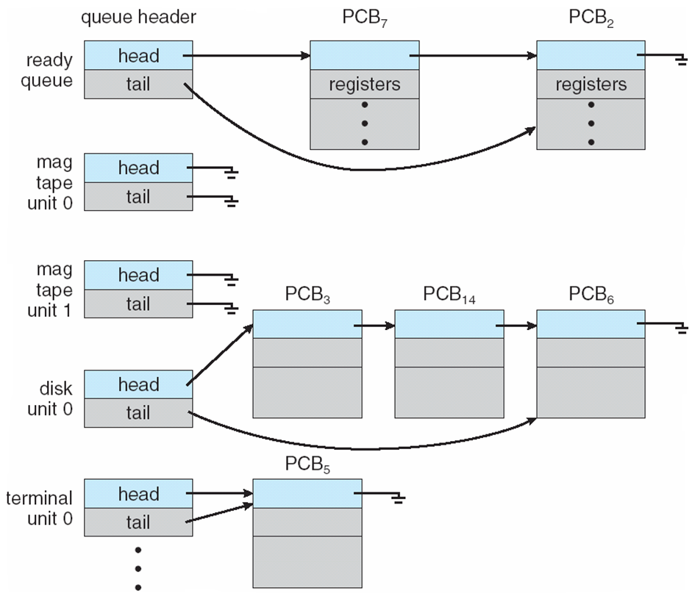
Ready Queue And Various I/O Device Queues

Slide 14
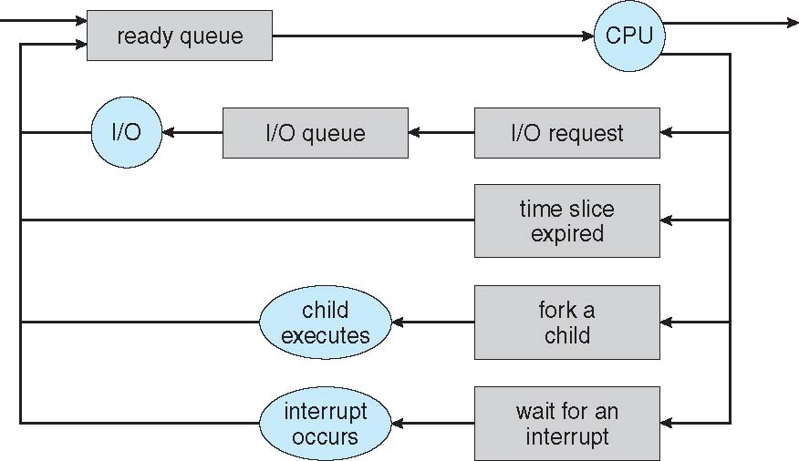
Representation of Process Scheduling
Queueing diagram represents queues, resources, flows

Slide 15
Schedulers
Short-term scheduler (or CPU scheduler) – selects which process should be executed next and allocates CPU
Sometimes the only scheduler in a system
Short-term scheduler is invoked frequently (milliseconds) ⇒ (must be fast)
Long-term scheduler (or job scheduler) – selects which processes should be brought into the ready queue
Long-term scheduler is invoked infrequently (seconds, minutes) ⇒ (may be slow)
The long-term scheduler controls the degree of multiprogramming
Processes can be described as either:
I/O-bound process – spends more time doing I/O than computations, many short CPU bursts
CPU-bound process – spends more time doing computations; few very long CPU bursts
Long-term scheduler strives for good process mix

Slide 16
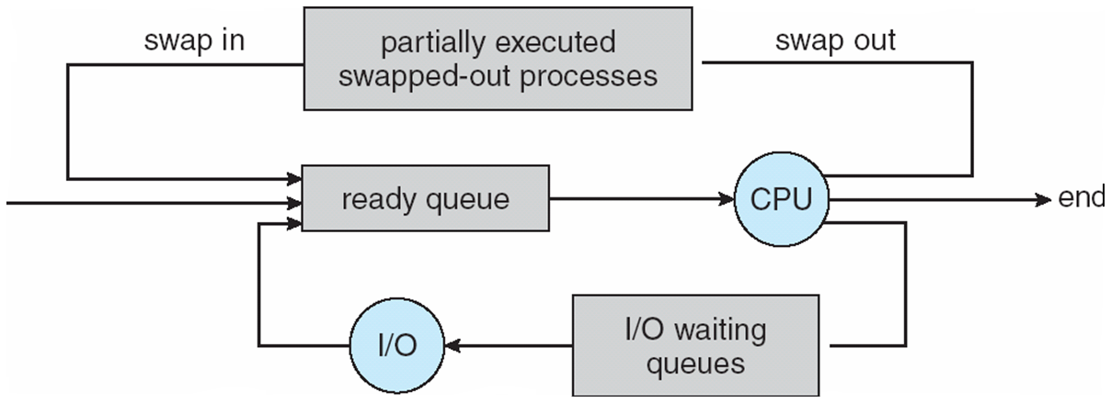
Addition of Medium Term Scheduling
Medium-term scheduler can be added if degree of multiple programming needs to decrease
Remove process from memory, store on disk, bring back in from disk to continue execution: swapping

Slide 17
Multitasking in Mobile Systems
Some mobile systems (e.g., early version of iOS) allow only one process to run, others suspended
Due to screen real estate, user interface limits iOS provides for a
Single foreground process- controlled via user interface
Multiple background processes– in memory, running, but not on the display, and with limits
Limits include single, short task, receiving notification of events, specific long-running tasks like audio playback
Android runs foreground and background, with fewer limits
Background process uses a service to perform tasks
Service can keep running even if background process is suspended
Service has no user interface, small memory use

Slide 18
Context Switch
When CPU switches to another process, the system must save the state of the old process and load the saved state for the new process via a context switch
Context of a process represented in the PCB
Context-switch time is overhead; the system does no useful work while switching
The more complex the OS and the PCB ➔ the longer the context switch
Time dependent on hardware support
Some hardware provides multiple sets of registers per CPU ➔ multiple contexts loaded at once

Slide 19
Operations on Processes
System must provide mechanisms for:
process creation,
process termination,
and so on as detailed next

Slide 20
Process Creation
Parent process create children processes, which, in turn create other processes, forming a tree of processes
Generally, process identified and managed via a process identifier (pid)
Resource sharing options
Parent and children share all resources
Children share subset of parent’s resources
Parent and child share no resources
Execution options
Parent and children execute concurrently
Parent waits until children terminate

Slide 21
A Tree of Processes in Linux

Slide 22
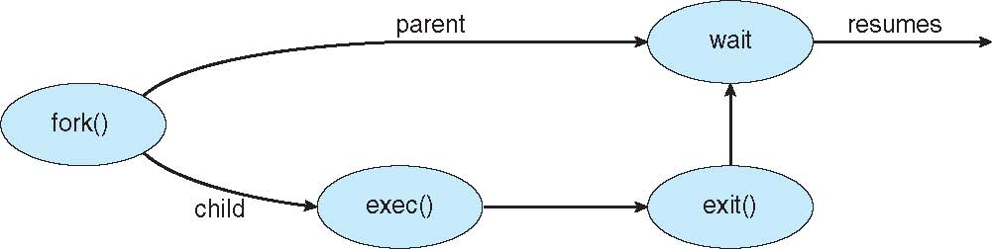
Process Creation (Cont.)
Address space
Child duplicate of parent
Child has a program loaded into it
UNIX examples
fork() system call creates new process
exec() system call used after a fork() to replace the process’ memory space with a new program

Slide 23
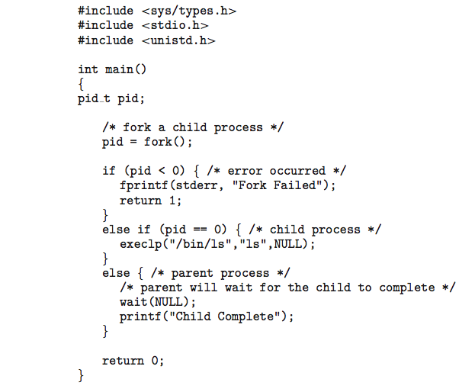
C Program Forking Separate Process

Slide 24
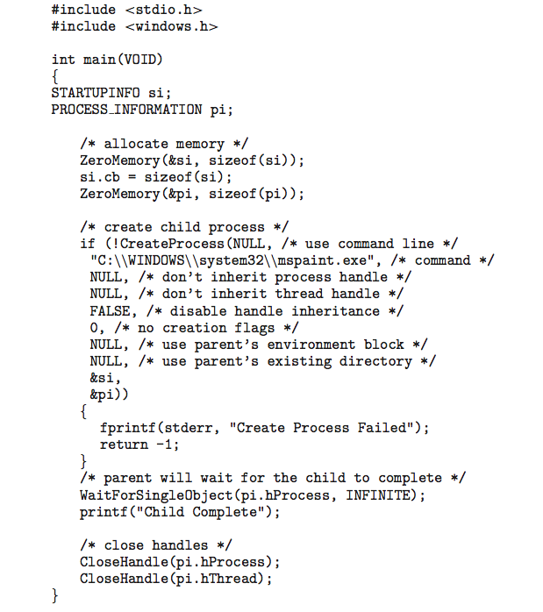
Creating a Separate Process via Windows API

Slide 25
Process Termination
Process executes last statement and then asks the operating system to delete it using the exit() system call.
Returns status data from child to parent (via wait())
Process’ resources are deallocated by operating system
Parent may terminate the execution of children processes using the abort() system call. Some reasons for doing so:
Child has exceeded allocated resources
Task assigned to child is no longer required
The parent is exiting and the operating systems does not allow a child to continue if its parent terminates

Slide 26
Process Termination
Some operating systems do not allow child to exists if its parent has terminated. If a process terminates, then all its children must also be terminated.
cascading termination. All children, grandchildren, etc. are terminated.
The termination is initiated by the operating system.
The parent process may wait for termination of a child process by using the wait()system call. The call returns status information and the pid of the terminated process
pid = wait(&status);
If no parent waiting (did not invoke wait()) process is a zombie
a process that has completed execution (via the exit system call) but still has an entry in the process table: it is a process in the "Terminated state“
If parent terminated without invoking wait , process is an orphan
an orphan process is a process that is still executing, but whose parent has died

Slide 27

Multiprocess Architecture – Chrome Browser
Many web browsers ran as single process (some still do)
If one web site causes trouble, entire browser can hang or crash
Google Chrome Browser is multiprocess with 3 different types of processes:
Browser process manages user interface, disk and network I/O
Renderer process renders web pages, deals with HTML, Javascript. A new renderer created for each website opened
Runs in sandbox restricting disk and network I/O, minimizing effect of security exploits
Plug-in process for each type of plug-in

Slide 28
End of Chapter 3

